Slide 1
Privacy and Technology
By Levi George

Slide 2
Content
History of Privacy Issues
Current Issues regarding privacy
Future issues
How to protect
What aspiring developers can do

Slide 3
History of Technology infringing on Privacy and rights
Olmstead v. United States (1928)
Olmstead violated Prohibition laws and was selling massive amounts of alcohol making hundreds of thousands of dollars (millions in our time)
Federal Agents wiretapped the phone lines that lead into his building from buildings adjacent to it (no home invasion)
Recording many phone conversations and eventually brought him to court
Earlier court rulings were upheld that the agents were within their rights to wiretap.
Katz v. United States (1967)
Small listening devices planted on phone booth to listen to Katz’s conversations regarding illegal sports betting
Ruled against the federal agents who did this, citing “expectation of privacy”
Kyllo v. United States (1992)
Federal agents used thermal imaging to determine Kyllo’s actions within his home
“Off-the-Wall” vs. “Through-the-Wall” and Public availability of equipment

Slide 4
Current issues
Drones
Can be flown near windows to examine inside of home
Online Social Media Tracking
Facebook Pixel
Cookies
Security Cameras and surveillance states
U.K. and China have cameras nationwide.

Slide 5
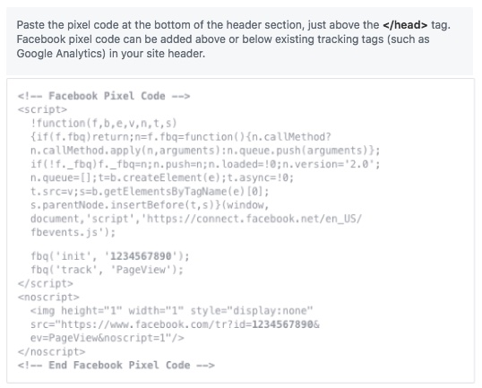
Facebook Pixel

Slide 6
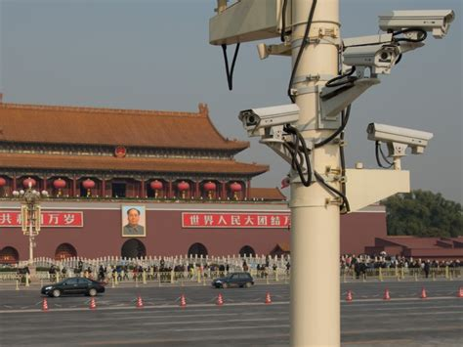
Chinese Cameras

Slide 7
New Technologies, New privacy risks
DNA Testing
There are no laws protecting your DNA
Insurance companies could buy your DNA and discriminate against you because of genetic tendencies toward diseases
Self-Driving Cars
Data and GPS info
How cars collect info of world around them
Quantum Computers
The end of encryption

Slide 8
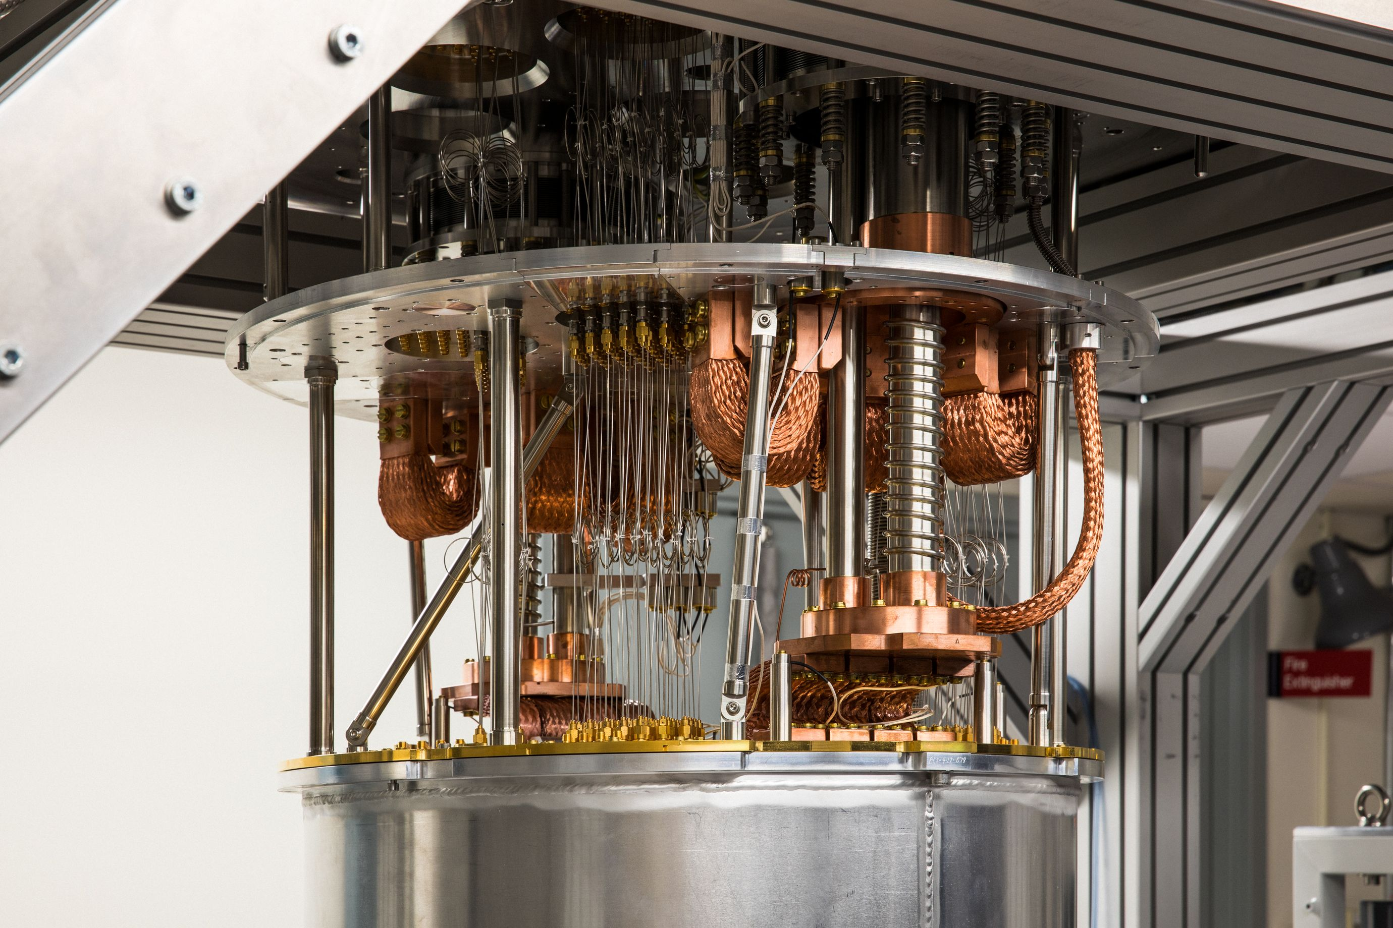
Quantum Computer

Slide 9
Prevention and Protection
Be legally proactive
Talk to your senator
Form petitions
Be aware
Understanding the risk you are at makes you more capable of defending yourself from online threats
Tools
By blocking ads, you deter ads and the collection of data
Ad blockers
Brave, FireFox, Tor
Operating Systems (Kali/Tails)
Abstinence

Slide 10

The Onion Router (TOR)
What is TOR exactly
Developed by the U.S. Navy and is continually reviewed and supported
TOR is a browser and routing scheme that will send your data through a series of servers which remove identifying information and encrypt the data
NSA has failed to decrypt or break the protocol

Slide 11
Tails and BRave
Tails
Uses TOR to obscure IP
Doesn’t send data to anyone
Provides Security tools
Brave
Blocks numerous trackers
Allows TOR for added security when you really want privacy

Slide 12
Software developer standpoint
Wikileaks
When you see something bad or unethical at your place of work, report it or leak it
Limit trackers
While useful, they can be pervasive and deeply revealing without being invasive
Limit access to hardware
Software can’t invade or violate privacy unless it has weaknesses or accesses hardware components on the device

Slide 13
WikiLeaks
Edward Snowden
Exposed NSA’s surveillance of American people
Has fled to Russia because of infamy and charges of treason
Wikileaks is anonymous
Used to expose U.S. actions in Afghanistan
CIA software and programs

Slide 14
Conclusion
Computers are valuable to everyday life but are also vulnerable and dangerous
However, this doesn’t mean don’t use them
Use them, but wisely.

Slide 15
Sources
https://blog.hootsuite.com/facebook-pixel/ (source of pixel code)
businessinsider.com/china-social-credit-system-things-you-can-do-wrong-and-punishments-2018-4 (source of camera image)
https://www.technologyreview.com/2018/02/21/145300/serious-quantum-computers-are-finally-here-what-are-we-going-to-do-with-them/ (Quantum computer photo)
https://www.techradar.com/news/internet/wikileaks-8-biggest-leaks-in-its-history-911493/2 (Wikileaks Stories)
https://www.tomsguide.com/us/what-is-tor-faq,news-17754.html (Tor Photo)

